Slide 1






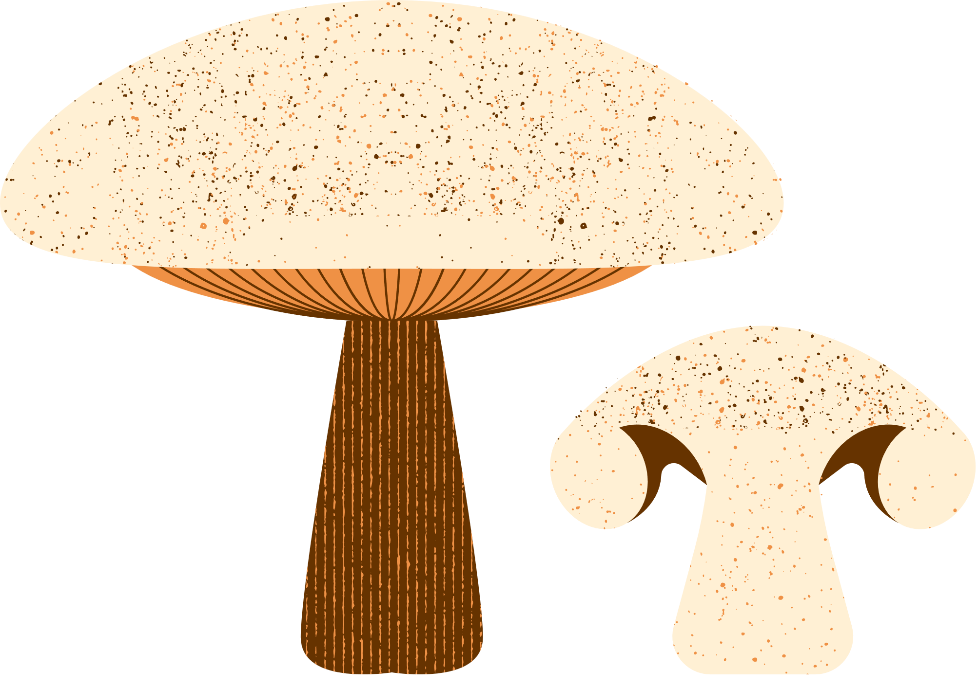


Minimizing Carbon Footprint in Diet Plans
Tommaso Salvatori & Rory Wilson

Slide 2



Food production = 26% of global emissions
Increasing environmental awareness​
500% increase in vegans in the U.S. since 2014​
Practical challenges remain

Slide 3

Food production = 26% of global emissions
Increasing environmental awareness​
500% increase in vegans in the U.S. since 2014​
Practical challenges remain

Slide 4
Food production = 26% of global emissions
Increasing environmental awareness​
500% increase in vegans in the U.S. since 2014​
Practical challenges remain
What foods reduce
emissions?

Slide 5
Food production = 26% of global emissions
Increasing environmental awareness​
500% increase in vegans in the U.S. since 2014​
Practical challenges remain
What foods reduce
emissions?
Is it expensive?​

Slide 6
Food production = 26% of global emissions
Increasing environmental awareness​
500% increase in vegans in the U.S. since 2014​
Practical challenges remain
What foods reduce
emissions?
Is it expensive?​
What about my
dietary needs?

Slide 7
Food production = 26% of global emissions
Increasing environmental awareness​
500% increase in vegans in the U.S. since 2014​
Practical challenges remain
What foods reduce
emissions?
Is it expensive?​
What about my
dietary needs?
Can I still meet nutritional requirements?

Slide 8




Emissions - kg CO2
Nutritients - macro & micro
Price - $
FDA Nutritional Requirements
43 Foods

Slide 9
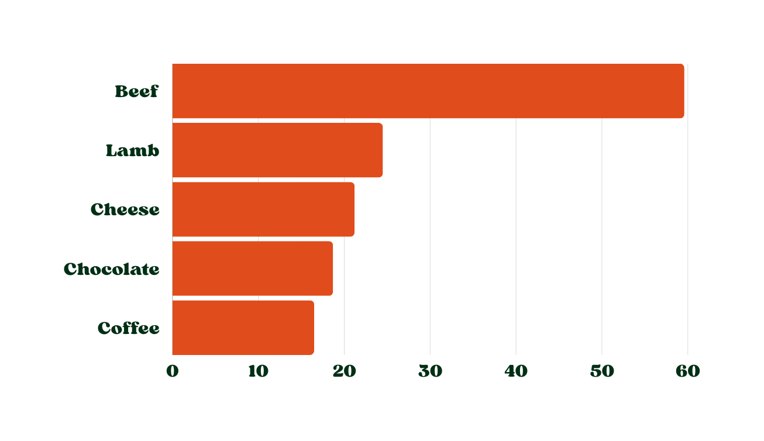
Emissions - kg CO2
Nutritients - macro & micro
Price - $
FDA Nutritional Requirements
43 Foods
Highest CO2 Emitting Foods (per kg)

Slide 10


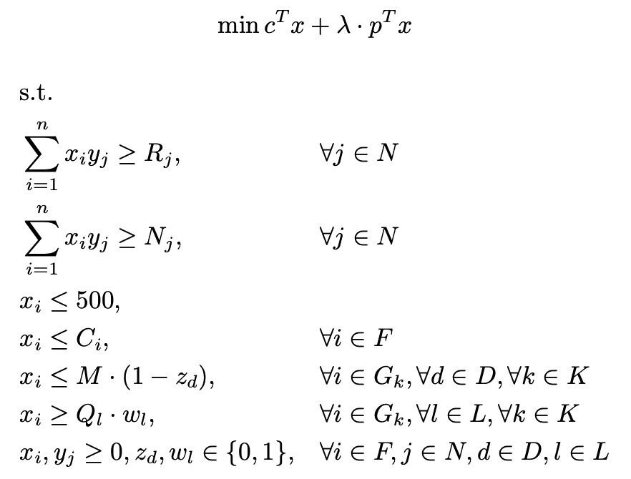
MIO

Slide 11

MIO
minimize emissions and price (λ)

Slide 12
MIO
minimize emissions and price (λ)
meet nutritional requirements

Slide 13
MIO
minimize emissions and price (λ)
meet nutritional requirements
limit individual food quantity

Slide 14
MIO
minimize emissions and price (λ)
meet nutritional requirements
limit individual food quantity
enforce dietary preferences

Slide 15

Results
Optimal
No Gluten
1.96 kg CO2: -58%
$4.80
2,800 calories
No Gluten
4.76 kg CO2 (+1%)
$13.10
2,800 calories
4.76 kg CO2 (+1%)
$13.1
2,800 calories
Keto
Cheapest
9.33 kg CO2 (+98%)
$8.70
2,687 calories
4.61 kg CO2 (-2%)
$2.78
2,800 calories

Slide 16

Results
Optimal
No Gluten
1.96 kg CO2: -58%
$4.80
2,800 calories
No Gluten
4.76 kg CO2 (+1%)
$13.10
2,800 calories
Shaquille O’Neal
4.76 kg CO2 (+1%)
$13.1
2,800 calories
7' 1"
324 lbs
NBA Hall of Famer
3.99 kg CO2 (-70% )
$9.00
8,609 calories
294g protein
Keto
Cheapest
9.33 kg CO2 (+98%)
$8.70
2,687 calories
4.61 kg CO2 (-2%)
$2.78
2,800 calories

Slide 17






Specifications | Specifications | Specifications
High meat | Fish ≥ 1 Serving | Coffee
No fad diets / intolerances | Alcohol f | VERY price sensitive
Rory Diet

Slide 18
Specifications | Specifications | Specifications
High meat | Fish ≥ 1 Serving | Coffee
No fad diets / intolerances | Alcohol f | VERY price sensitive
Rory Diet
Ingredients:
Chicken: 300g
Fish: 100g
Turnips: 200g
Coffee: 10g
Eggs: 24g
Cabbage: 98g
Peanuts: 57g
Bread: 318g
Tofu: 223g
Mandarins: 250g
Peas: 250g
Soybean oilL 23g
Soymilk: 2.6g
Wine: 100g

Slide 19
Specifications | Specifications | Specifications
High meat | Fish ≥ 1 Serving | Coffee
No fad diets / intolerances | Alcohol f | VERY price sensitive
Rory Diet
Ingredients:
Chicken: 300g
Fish: 100g
Turnips: 200g
Coffee: 10g
Eggs: 24g
Cabbage: 98g
Peanuts: 57g
Bread: 318g
Tofu: 223g
Mandarins: 250g
Peas: 250g
Soybean oilL 23g
Soymilk: 2.6g
Wine: 100g
Diet Plan:
Breakfast: Tofu scrabble served with bread, 2 Mandarin
Lunch: Chicken and pea salad, diced turnips & cabbage
Snack: Peanut butter toast, coffee with soymilk
Dinner: Fish with turnip puree, soybean cabbage slaw, served with a glass of wine

Slide 20
Specifications | Specifications | Specifications
High meat | Fish ≥ 1 Serving | Coffee
No fad diets / intolerances | Alcohol f | VERY price sensitive
Rory Diet
Ingredients:
Outcome
Chicken: 300g
Fish: 100g
Turnips: 200g
Coffee: 10g
Eggs: 24g
Cabbage: 98g
Peanuts: 57g
Bread: 318g
Tofu: 223g
Mandarins: 250g
Peas: 250g
Soybean oilL 23g
Soymilk: 2.6g
Wine: 100g
4.20 kg CO2 (-12%)
$5.28
2,800 calories
Diet Plan:
Breakfast: Tofu scrabble served with bread, 2 Mandarin
Lunch: Chicken and pea salad, diced turnips & cabbage
Snack: Peanut butter toast, coffee with soymilk
Dinner: Fish with turnip puree, soybean cabbage slaw, served with a glass of wine

Slide 21



Impact
- 93,600 kg CO2
Class adoption
every year
- 334.3B kg CO2
U.S. adoption
every year

Slide 23





Practical Applications
User interface
Recipe generator
Integration into existing apps
Policy making
Next Steps
Further research into food emissions
Raise awareness to empower consumers

Slide 24
Thank You!
Rory Wilson & Tommaso Salvatori

